Slide 1
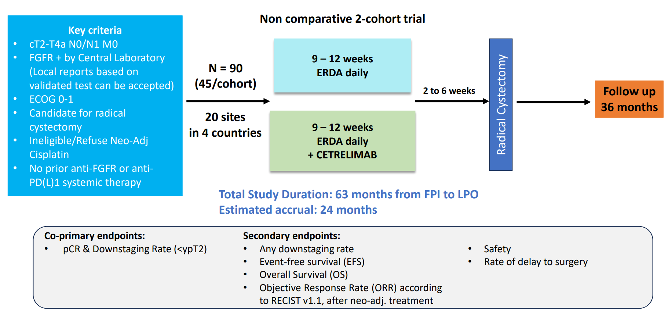

TPS4628 (Poster 419b): SOGUG-NEOWIN: A Phase 2, open-label, multi-centre, multi-national interventional trial evaluating the efficacy and safety of erdafitinib (ERDA) monotherapy and erdafitinib and cetrelimab (CET) as neoadjuvant treatment in cisplatin-ineligible patients with muscle-invasive bladder cancer (MIBC) whose tumours express FGFR gene alterations de Velasco G.¹, Necchi A.², Loriot Y.³, Hussain S.A. ⁴ 1 Hospital Universitario 12 de Octubre, Dept. of Medical Oncology, Madrid, Spain., ²IRCCS San Raffaele Hospital and Scientific Institute, Head of Genitourinary Medical Oncology, Milan, Italy, ³Gustave Roussy, Universite Paris Saclay, Dept. of Medical Oncology, Villejuif, France, ⁴ University of Sheffield, Academic Unit of Oncology, Dept. of Oncology and Metabolism, Sheffield, United Kingdom
This trial systematically address whether ERDA ± CET improves pCR in patients with FGFR-positive MIBC.
Subjects with MIBC (cT2-T4a N0/N1 M0) who harbour some specific alterations of the FGFR and are either ineligible for or refuse cisplatin based neoadjuvant chemotherapy were treated with 9 or 12 weeks of neoadjuvant ERDA (cohort 1) or ERDA+CET (cohort 2)
Background
The standard treatment for nonmetastatic MIBC is neoadjuvant cisplatin-based therapy followed by radical cystectomy (RC).
Many patients are ineligible for cisplatin.
Immune checkpoint inhibitors (ICIs) have changed the treatment landscape for metastatic urothelial cancer (mUC), including for cisplatin-ineligible patients. Based on these results, ICIs are being explored as neoadjuvant treatment in resectable UC with preliminary data suggesting antitumor activity.
ERDA is a Fibroblast Growth Factor Receptor (FGFR) inhibitor, which has shown efficacy in mUC with select FGFR2/3 mutations/fusions.
ERDA plus CET demonstrated clinically meaningful activity in patients with newly diagnosed FGFR-altered mUC in the phase 2 NORSE trial.
This study will assess whether ERDA plus CET will improve the pathological complete response (pCR) rate in patients with FGFR+ MIBC who are candidates for RC and are ineligible for or refuse neoadjuvant cisplatin-based therapy.
Study Design
Key eligibility criteria
ECOG PS 0-1
Presence of a select FGFR alteration
Pure or predominant UC histology
Decline or ineligible for cisplatin-based chemotherapy as defined by one of the following criteria:
impaired renal function (GFR<60 mL/min),
≥ grade 2 hearing loss, or
≥ grade 2 peripheral neuropathy;
Patients are considered fit for cystectomy
No prior FGFR-targeted or anti PD-(L)1 therapy
No prior systemic therapy, radiation or surgery (except TURBT or biopsies) for bladder cancer
Prior BCG was allowed if completed ≥ 6 weeks prior to initiation of study treatment
The trial is approved in 4 countries (France, Italy, Spain and UK). The first patient was pre-screened on 31-Jan-2024.
As of March 31, 2025, 91 patients were pre-screened, 9 were FGFR2/3 positive, and 5 were enrolled.
EU CT Number 2024-512573-27-01; NCT06511648
This study is sponsored by SOGUG (Spanish Oncology Genitourinary Group) and funded by Janssen Pharmaceutica NV, a Johnson & Johnson Company. Erdafitinib (JNJ-42756493) was discovered in collaboration with Astex Pharmaceuticals

