Slide 1


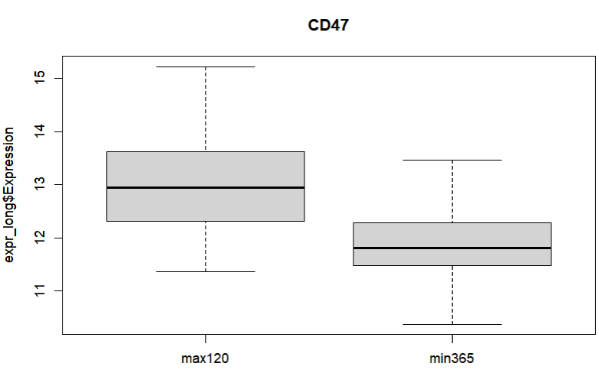
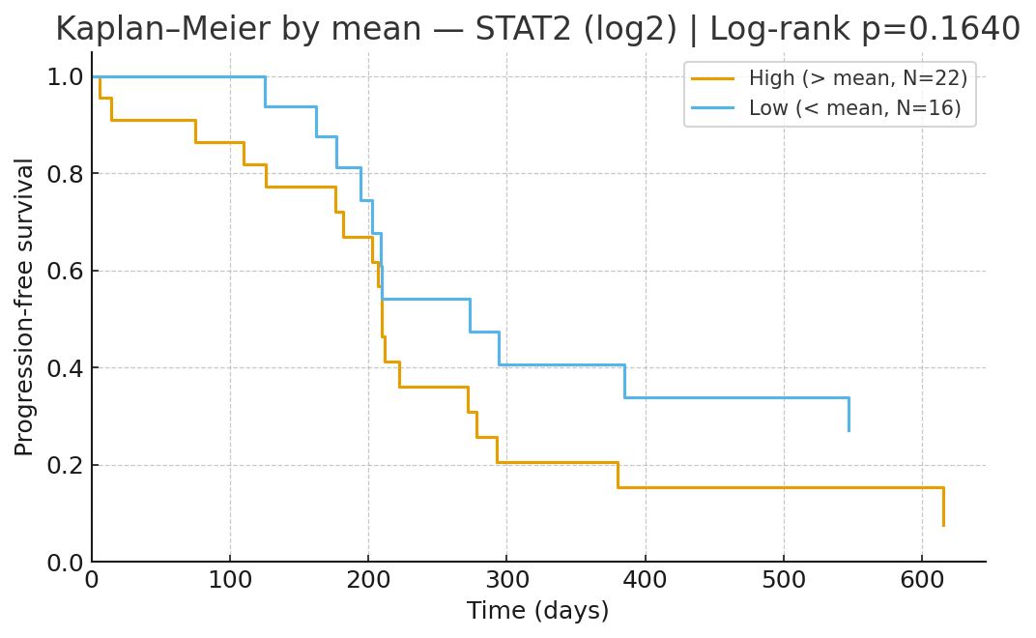
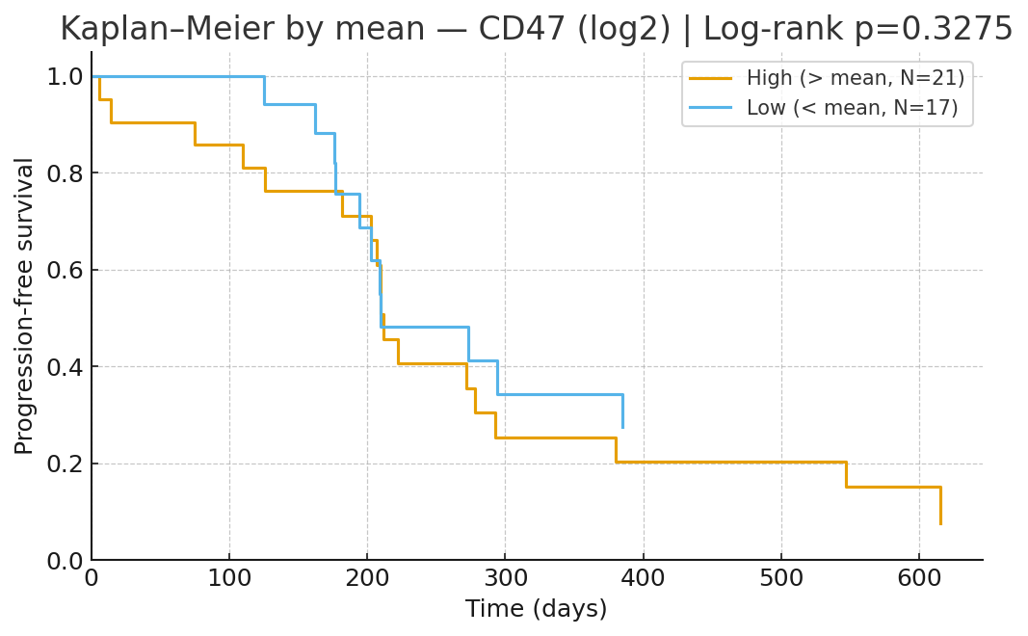
Defining Molecular Correlates of Response Using Spatial Transcriptomics in the SOGUG-AUREA Trial
Pablo Alvarez Ballesteros^{1,2}, Iciar García-Carbonero³, Emilio Esteban-González⁴, Alvaro Pinto⁵, David Lorente⁶, Alfonso Gómez de Liaño⁷, Esther Martínez Ortega⁸, Laura Jimenez Colomo⁹, Javier Puente¹⁰, Iria González¹¹, Ovidio Fernandez Calvo¹², Georgia Anguera¹³, Isabel Mendizabal¹⁴, Enrique Pérez Navarro², Jose Ignacio Dominguez Dominguez², Jorge Esteban Villarrubia^{1,2}, Enrique González-Billalabeitia^{1,2}, Guillermo de Velasco^{1,2}.
¹Medical Oncology Department. Hospital Universitario 12 de Octubre, Madrid, Spain; ²Instituto de Investigación Biosanitaria – Hospital 12 de Octubre (i+12) Madrid, Spain; ³Medical Oncology Department. Hospital Virgen de la Salud, Toledo, Spain; ⁴Medical Oncology Department. Hospital Universitario Central de Asturias, Oviedo, Spain; ⁵Medical Oncology Department. Hospital Universitario La Paz-IdiPAZ, Madrid; ⁶Medical Oncology Department. Hospital Provincial de Castellón, Castellón, Spain; ⁷Medical Oncology Department. Complejo Hospitalario Universitario Insular - Materno Infantil (CHUIMI), Las Palmas de Gran Canaria, Spain; ⁸Medical Oncology Department. Hospital Universitario de Jaén, Jaén, Spain; ⁹Medical Oncology Department. Institut Català d'Oncologia (ICO) Hospitalet, L’Hospitalet de Llobregat, Spain; ¹⁰Medical Oncology Department. Hospital Clínico Universitario San Carlos, Madrid, Spain; ¹¹Medical Oncology Department. Hospital Son Llàtzer, Mallorca, Spain; ¹²Medical Oncology Department. Complejo Hospitalario Universitario Ourense, Ourense, Spain; ¹³Medical Oncology Department. Hospital de la Santa Creu i Sant Pau, Barcelona, Spain; ¹⁴CIC Biogune-Center for Cooperative Research in Biosciences, Vizcaya, Spain.
FUNDING: Spanish Oncology GenitoUrinary Group (SOGUG) as Sponsor. Funded by a research grant from Roche Farma S.A. Spain
Corresponding author address: pabloteros@gmail.com
1
BACKGROUND
The Phase II AUREA trial tested atezolizumab plus split-dose cisplatin and gemcitabine in cisplatin-ineligible patients with advanced urothelial carcinoma.
The regimen achieved an ORR of 48.5% (10.6% CR), median PFS of 6.9 months, and OS of 12.9 months, with manageable toxicity. We conducted a translational sub-study using GeoMx® DSP to explore compartment-specific RNA expression patterns in epithelium and stroma, aiming to identify molecular determinants of response.
|log₂FC|>0, FDR<0.2
Figure 1. Epithelial differential expression: responders vs. non-responders
Pretreatment epithelial regions of interest (ROIs) profiled by GeoMx® digital spatial profiling are ranked according to radiologic responders (PR/CR) versus non-responders. The distribution of effects is visibly unbalance toward higher epithelial signals on the responder side, with keratin family members and immune-signalling genes (notably STAT2/STAT3 and CTNNB1) featuring among the most expressed in responders. Bars/points are shown as log₂ fold-change (log₂FC) with FDR control; positive log₂FC corresponds to higher expression in responders, and top items cross the FDR < 0.20 threshold. Across the panel, signals cluster in epithelial rather than stromal compartments, reinforcing a compartment-specific pattern.
2
METHODS
Pretreatment FFPE biopsies from patients were analyzed using the GeoMx® DSP Immune Pathways panel, targeting 84 immune-related transcripts.
Epithelial and stromal compartments were profiled separately, and gene expression was compared across three clinical subgroups: responders (partial or complete radiological response) vs. non-responders, early progressors (PFS <120 days) vs. long-term benefit (PFS >365 days), and durable vs. non-durable responders.
Transcripts with promising differences were then evaluated in univariate Cox proportional hazards models for PFS and by linear regression against continuous PFS.
log₂FC 1.27; FDR=0.12
Figure 2. Epithelial differential expression by clinical course: early progressors vs. long-term survivors
Epithelial transcripts are ranked comparing early progressors (PFS < 120 days) with long-term survivors (PFS > 365 days). The script highlights the differential expression of CD47 in early-responders as the leading signal (log₂FC = 1.27; FDR = 0.12 on the display). A trend to the upregulation is also observed in STAT2, STAT3 and CTNNB1, without reaching the significance. The overall distribution suggests a subset of immune interaction pathways enriched in early progressors.
Gene | LogFC | p-value | Adj.p-value
CD47 | -1.27432 | 0.00165 | 0.12069
STAT2 | -0.79047 | 0.02820 | 0.76872
STAT3 | -0.68737 | 0.03159 | 0.76872
CTNNB1 | -0.92142 | 0.05280 | 0.85259
3
RESULTS
Out of 52 patients, 43 samples were evaluable, yielding 168 tissue areas for spatial analysis. The epithelial compartment revealed the most prominent differential expression patterns.
STAT2, STAT3, CTNNB1 and members of the Keratin family stood out in responder versus non-responder comparisons (|log₂FC|>0, FDR<0.2), while CD47 emerged as significantly elevated in early progressors (log₂FC 1.27; FDR=0.12).
High epithelial STAT2 expression showed a trend toward association with shorter PFS (HR 1.35; 95% CI 0.98–1.85; p = 0.067), and linear regression confirmed an inverse relationship (slope –74.7; p = 0.014). CD47 demonstrated a similar non-significant trend in Cox analysis (HR 1.35; 95% CI 0.92–1.97; p = 0.120) and linear regression (slope –48.5; p = 0.123). Neither STAT3 nor CTNNB1 reached statistical significance.
Gene | Cox HR | 95 % CI for HR | p-value (Cox) | Linear slope | p-value (lin) | R²
STAT2 | 1.3467 | 0.9793 - 1.8519 | 0.0671 | –74.70 | 0.0137 | 0.157
STAT3 | 1.2094 | 0.8893 – 1.6447 | 0.2255 | –54.52 | 0.0939 | 0.076
CTNNB1 | 1.1861 | 0.9145 – 1.5384 | 0.1984 | –44.29 | 0.1075 | 0.070
CD47 | 1.3508 | 0.9247 – 1.9733 | 0.1199 | –48.46 | 0.1231 | 0.064
Figure 3. Association of epithelial expression with progression-free survival (PFS) using Cox propotional-hazards model and linear regression.
Higher STAT2 shows a trend toward shorter PFS (Cox HR 1.35 [95% CI 0.98–1.85], p=0.067; linear regression slope –74.7, p=0.014). CD47 shows a similar, non-significant trend (HR 1.35 [0.92–1.97]; slope –48.5, p=0.123). Graphic representation with Kaplan-Meier models using a mean split (high and low expresión) shows a trend toward better survival among patients with low expression of STAT2 and CD47.
4
CONCLUSION
Our spatial transcriptomic analysis supports that high epithelial STAT2 expression and CD47 upregulation may be associated with differential progression outcomes following chemoimmunotherapy treatment.
These preliminary, hypothesis-generating observations highlight the potential of spatial biomarker assessment in this setting, and further analyses will be presented.

